Slide 1


Slide 2
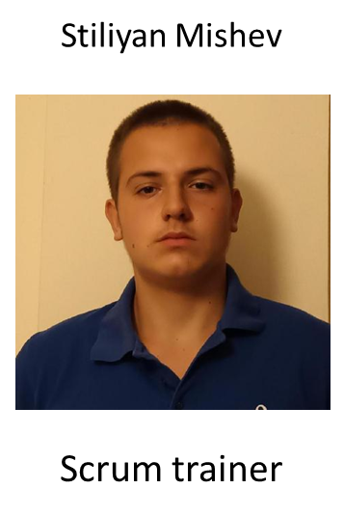
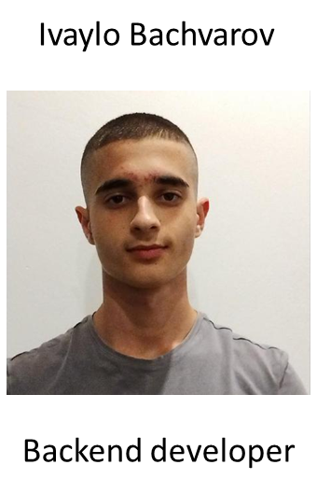
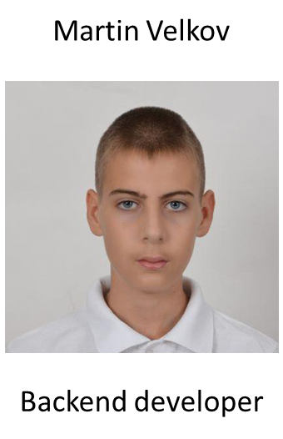
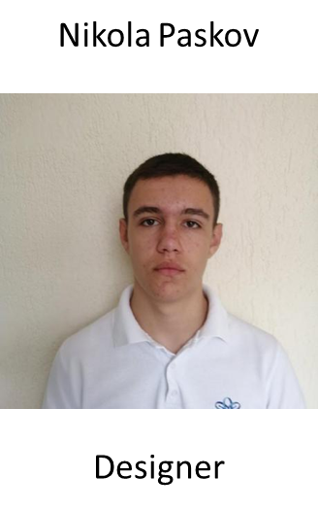
OUR TEAM

Slide 3

OUR IDEA

Slide 4
STAGES OF DEVELOPMENT
01
03
02
04
To come up with an idea
Game development
Design creation
Presentation

Slide 5








Using programs

Slide 6

Let’s get started with the game

